Slide 1
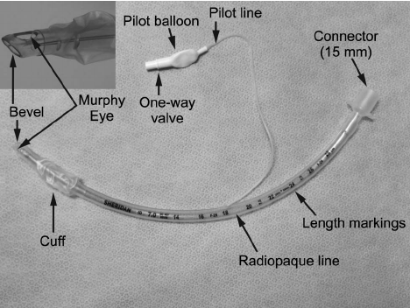
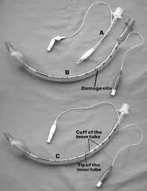
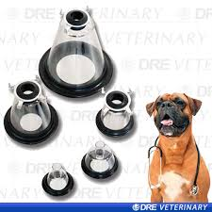
Anesthetic gas could be reached to the body by
1 ■ Tracheal tube
(endotracheal tube)
Tubes with cuff
Tubes without cuff
2 ■ Face mask
Various shape and size
according to different
muzzle shape

Slide 2
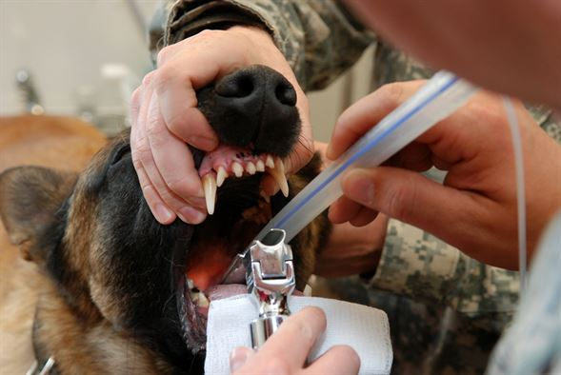
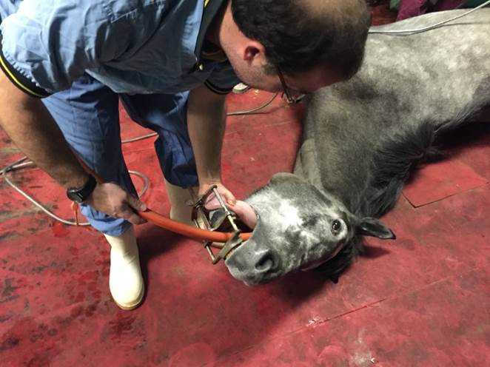
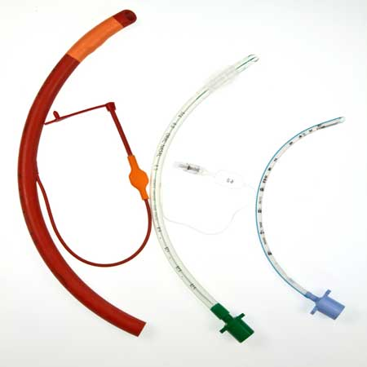
Intubation
● Blind (horse, Cow)
Size 20-30 for large animals
● With the aid of laryngoscope
(small animals)
Size 3-9 for small animals

Slide 3
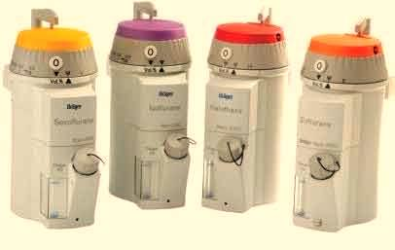
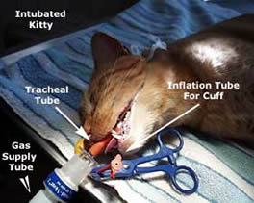
Inhalation anesthetics in clinical practice
● Halothane
● Isoflurane
● Sevoflurane
● Enflurane
● Desflurane
● Methoxyflurane
● Nitrous oxide (N₂O)

Slide 4
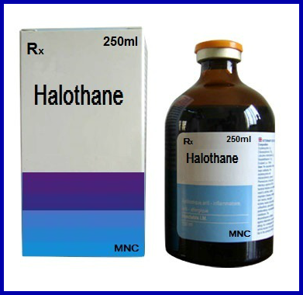
Halothane
Cheap in price
Volatile colorless nonirritant liquid
Should not be exposed to light
MAC 0.9%
(Minimum Alveolar Concentration)
Maintenance 1-2.5%
Cardiac depressant
Short period recovery
Hypotension, bradycardia, arrhythmia,

Slide 5
Isoflurane
Newer volatile anesthetic
MAC: 1.2
Boiling point: 48.5 degree celcius
Nonflammable
Induction and recovery are rapid
Mild pungency
advantage
Disadvantage

